Slide 1


2021
Long running
Tasks in Azure
Sergio Navarro Pino
Tech lead
10/10/2021
@snavarropino

Slide 2
@snavarropino

Slide 3


Long running tasks
Tech Lead @AnalyticAlways
Father of two & Developer & DevOps fan
Developer Technologies MVP
@snavarropino

Slide 4

Long running tasks
That kind of task that lasts more than the time a user can’t wait for the result.
30 secs?
60 sec?
1 hour?
The whole night?
Background jobs can be triggered by user interaction
or
Can be executed without requiring user interaction

Slide 5
Long running tasks. Examples
CPU-intensive jobs
I/O-intensive jobs
Batch jobs
Long-running workflows
Sensitive-data in a more secure location
for processing
Notes:
https://docs.microsoft.com/en-us/azure/architecture/best-practices/background-jobs
CPU-intensive jobs. Calculos matemáticos
I/O-intensive jobs. Sacar thumbnails de imágenes
Batch jobs, such as nightly data updates or scheduled processing. Mandar mails a todos los que han pedido hoy
Long-running workflows: provision de sistemas, gestion de pedidos
Sensitive-data processing where the task is handed off to a more secure location for processing

Slide 6
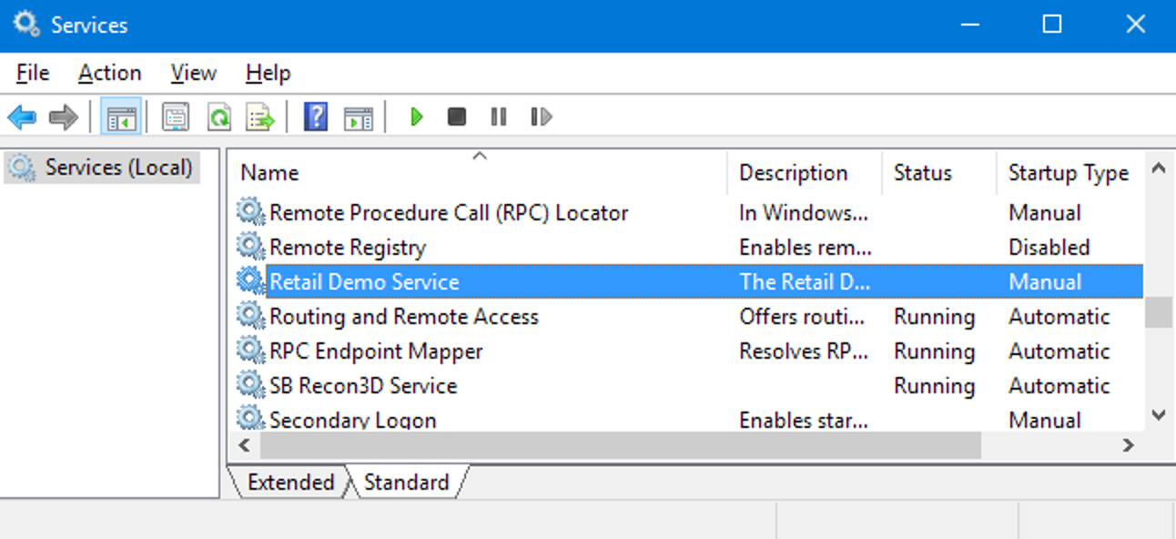
Classic solution

Slide 7

In a cloud first world? Theseus & the Minotaur

Slide 8

Disclaimer
Not covering all Azure options
I don’t have real experience with all options
Don’t expect an algorithm

Slide 9
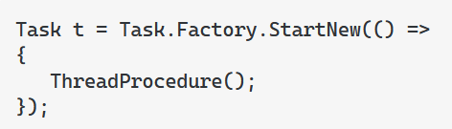
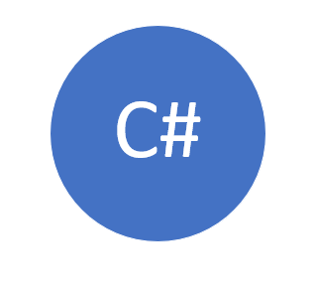
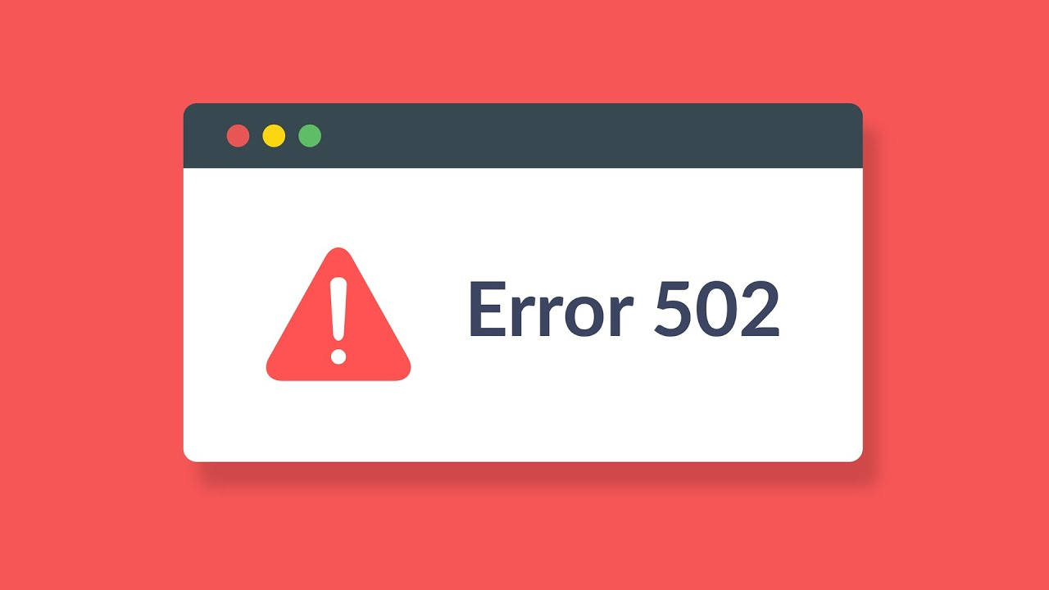
Common mistakes
Notes:
Ojo a lanzar threads y agotar el thread pool. Hay q dejar de hacer esas barbaridades.

Slide 10
Opportunity solutions
C#
ASP.NET Core Hosted Service
Hangfire
Notes:
Demo de hosted service

Slide 11

ASP.NET Core Hosted Service
Client & worker are coupled
Run in every instance. Take in account
Use same hardware, take care of users
Is not an Azure Solution, but a C# one
Tasks are stopped in deployments

Slide 12
Hangfire
Client & worker can be hosted in different applications. Still coupled
Is not an Azure Solution, but a C# one
Tasks are stopped in deployments

Slide 13
Azure App Service
Continuous
Triggered
Web job
Notes:
Preparado para tareas en background

Slide 14
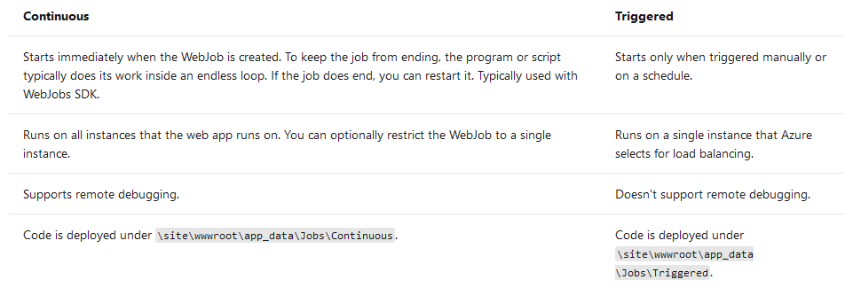
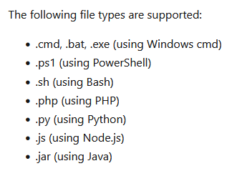
Azure App Service: Web jobs

Slide 15
Message queue design pattern

Slide 16
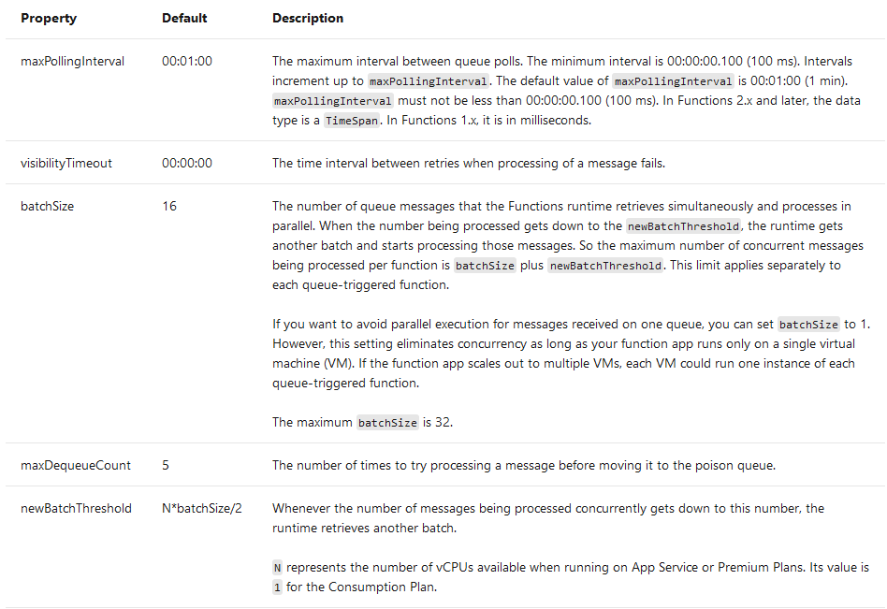
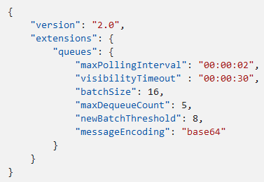
Message queue design pattern
Notes:
Demo de continuo
Metemos salida y errores

Slide 17
Azure App Service: Web jobs
Client & worker are decoupled
Lots of triggers
Run in every instance or in a single one. Triggers can help
Use same hardware, take care of users
Tasks are stopped in deployments => reentrancy
Notes:
Tips: always on

Slide 18
Serverless everywhere!
Azure Durable Functions
Azure Functions
Serverless
Notes:
Comentar el límite de 5 mins, ampliable a 10, de las funciones

Slide 19
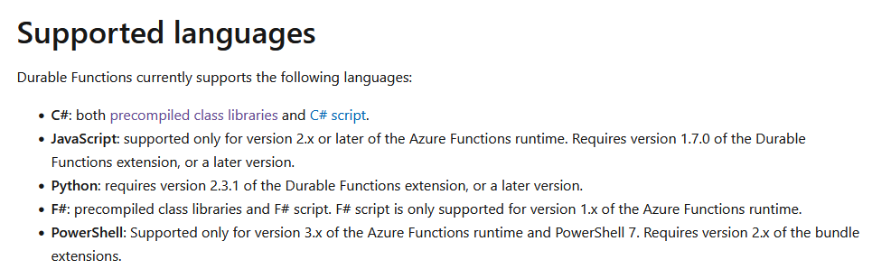
Durable functions
Notes:
Event sourcing
Activities must be reentrant
https://docs.microsoft.com/en-us/azure/azure-functions/durable/durable-functions-code-constraints

Slide 20
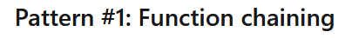
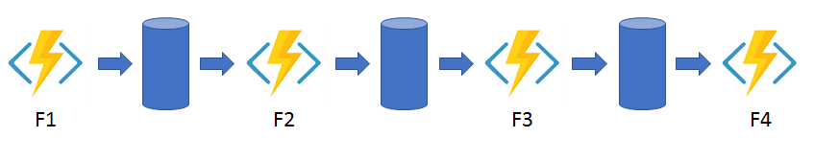
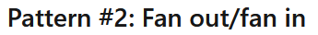
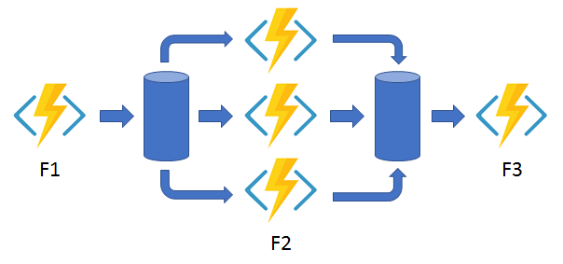
Durable functions patterns
Notes:
Demo de Durable

Slide 21
Azure Durable Functions
Azure functions 10 minutes limit!
Durable functions to the rescue, but each activity up to 10 minutes
Tasks are stopped in deployments
Sometimes quite complicated
@panicoenlaxbox
https://www.youtube.com/watch?v=EX_I6Qs-PAY

Slide 22
Containers
AKS
Azure Container Instance
Containers

Slide 23
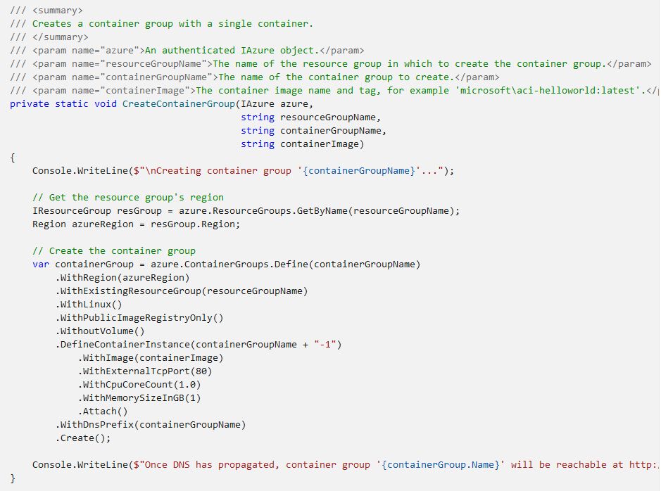
ACI

Slide 24
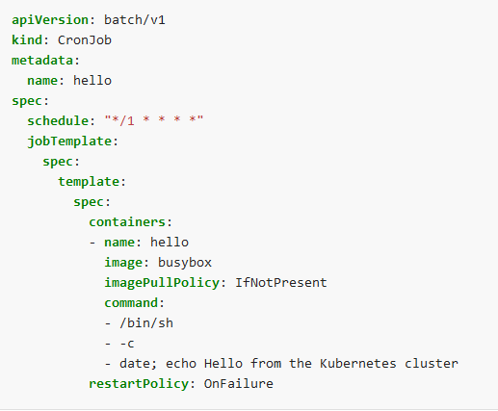
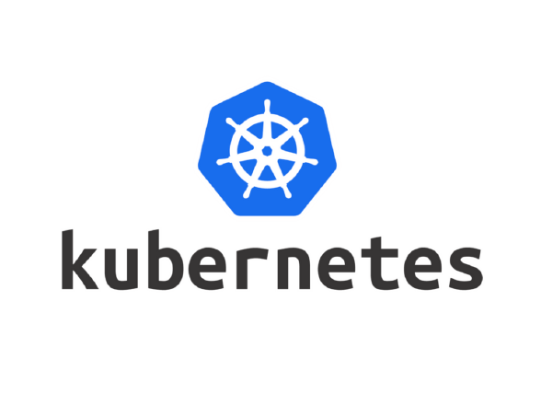
Kubernetes jobs

Slide 25
Containers
Any language!
Tasks are NOT stopped in deployments

Slide 26
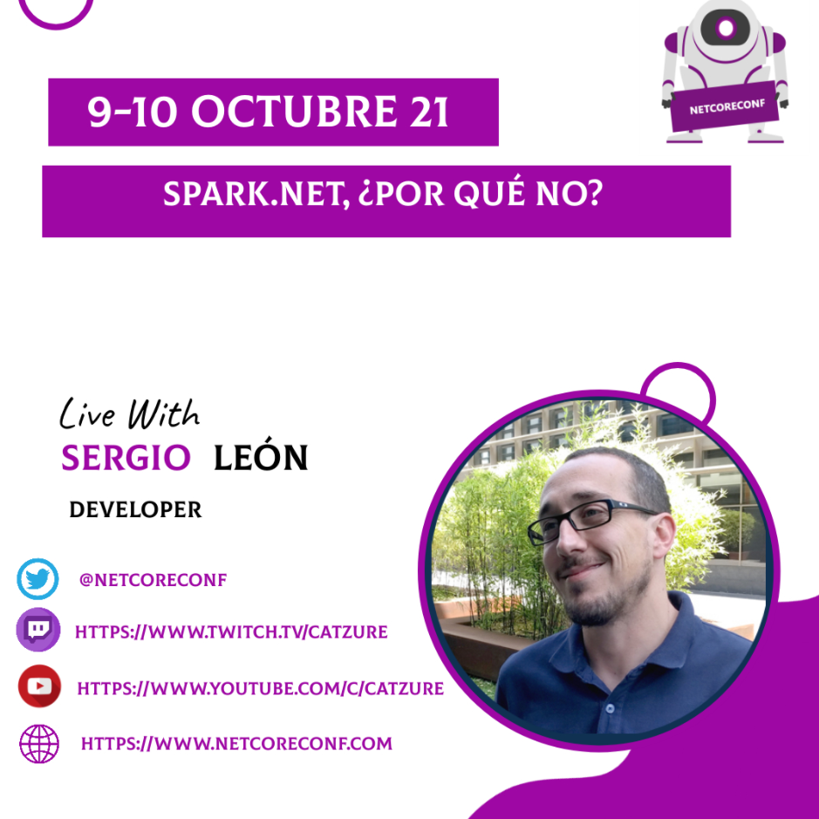
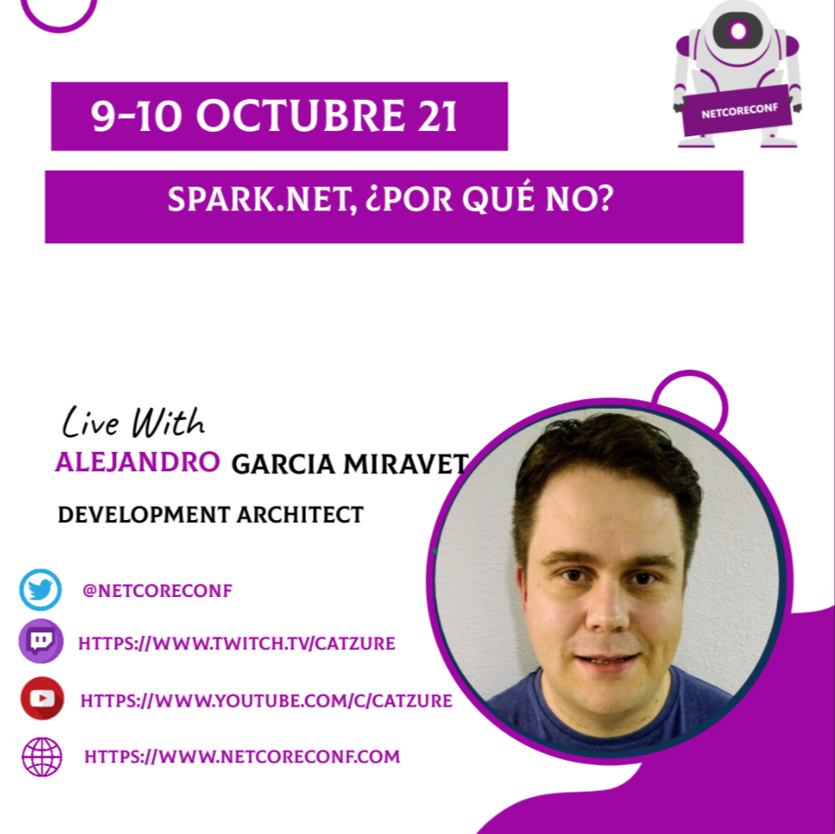
Spark & Databricks
Notes:
2 titanes

Slide 27
Azure batch
Container image
Executable
Batch
Notes:
HPC: high performance computing
https://docs.microsoft.com/en-us/azure/batch/batch-technical-overview

Slide 28
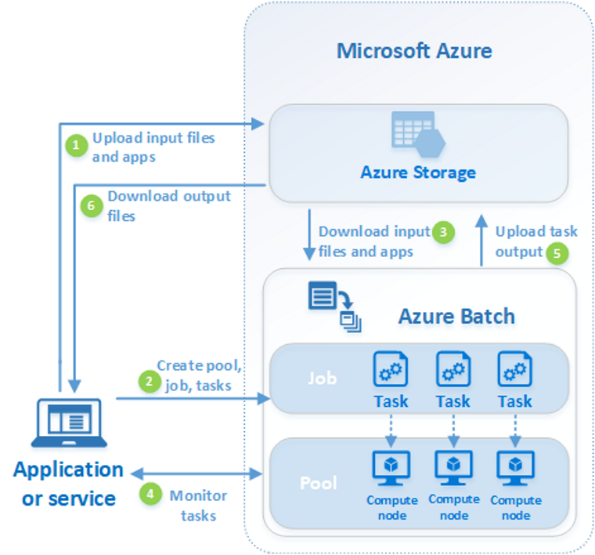
Azure batch
Key concepts:
Pool: Set of virtual machines
Job: Set of tasks
Task: An individual task to be executed in a pool node (VM)
Notes:
demo

Slide 29
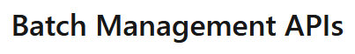
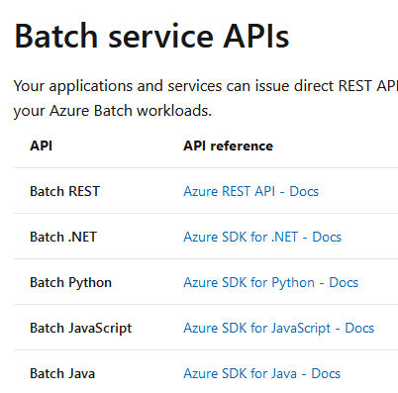
Azure batch
https://docs.microsoft.com/en-us/azure/batch/batch-apis-tools

Slide 30
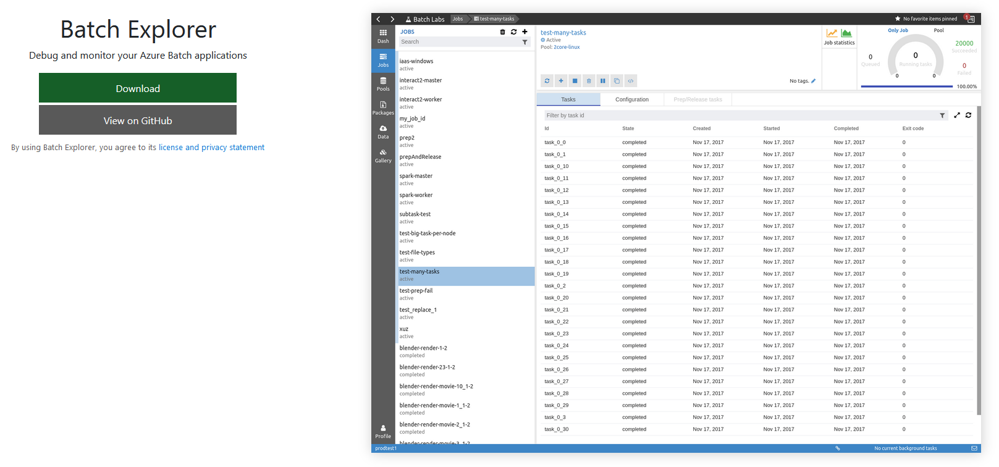
Azure batch

Slide 31
Azure batch
You pay for Storage & Virtual Machines
Low priority VM can be used
Take in account VM start time
Any language or stack.
Job is not stopped when you deploy

Slide 32
@snavarropino

Slide 33
More information:
info@netcoreconf.com
@Netcoreconf
Visit on:
netcoreconf.com
Thank´s

